Slide 1
Learning Process and Loop Problem

Slide 2
Switch learning process
When the switch receives a frame, it compares the source address of the frame with each entry in the forwarding table
If No match is found, the bridge will add to the table the frame source address and the Interface on which the frame was received.
If a match is found, the bridge updates the Interface number on which the frame was received if it is different from the one in the table also it updates the record time
Then, the switch compares the destination address of the frame with each entry in the forwarding table (MAC table)
If a match is found then
The bridge compares the interface number on which the frame was received and the interface number in the table, if they are different the bridge forwards the frame through the interface number stored in the table. Otherwise, if they are the same the switches discards (drops) the frame.
If no match is found, the switch floods the frame on all interfaces except the one on which the frame was received.

Slide 3
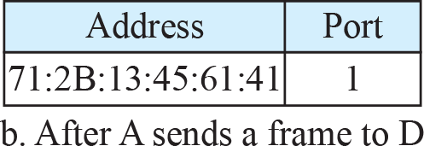
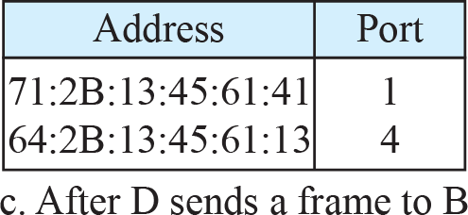
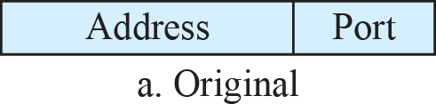
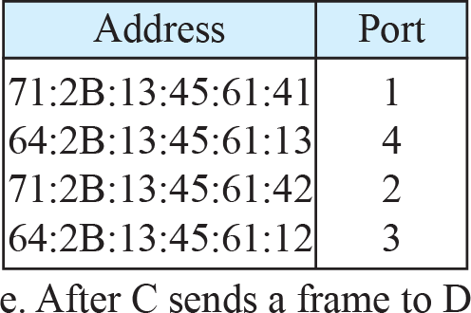
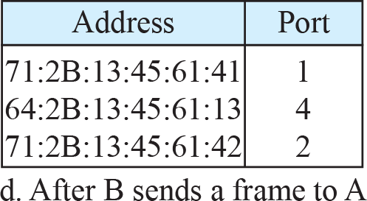
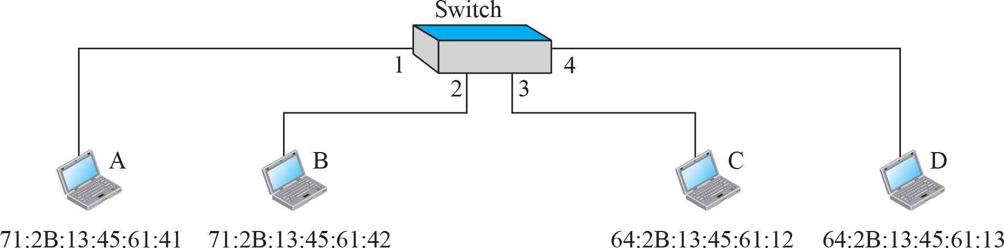
A learning switch and the process of learning

Slide 4
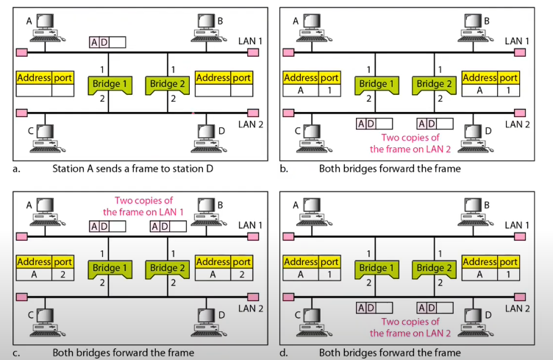

Slide 5
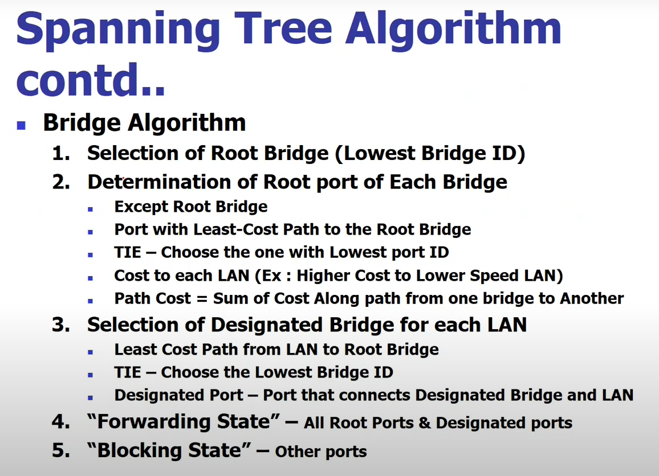

Slide 6
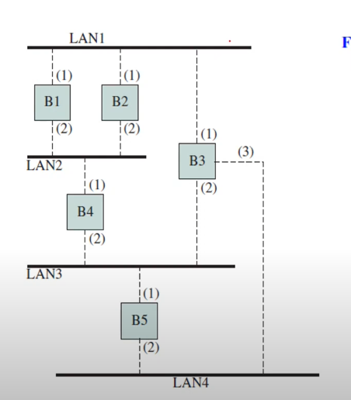

Slide 7
Video Reference
For better understanding you can watch and follow this video
https://www.youtube.com/watch?v=wQWbWUfzxpo&t=1319s

